Slide 1
Talha Ejaz (SP18-BCS-161) Waleed Butt (SP18-BCS-170)
Smart Construction Manager
Supervisor Name: Dr. Ashfaq Hussain Farooqi
Department of Computer Science,
COMSATS University Islamabad.

Slide 2
Topics
1
Introduction
Overall Description
Project Scope
Modules
System Limitation
Software Process Methodology
Tools and Technologies
Work Division
Requirements Identifying Technique
Functional Requirements
Non-Functional Requirements
External Interface Requirements
Conclusion

Slide 3
Introduction
2
Industry is moving towards automation.
Government has introduced automation in various fields (NADRA etc.).
Smart Construction Manager will automate construction procedure.
Land Allotments
Land Transfers
Map Approvals
Buying and Selling Property
Searching Construction Companies
Searching Labor
Utility Services

Slide 4
Overall Description
3

Slide 5
Overall Description [1/3]
4
Problem Statement
Slow procedures due to manual operations.
Difficulty in hiring construction companies & labor
Difficulty in following the SOPs of building control
Slow process of availing utility services (Water, Electricity, Gas etc.)

Slide 6
Overall Description [2/3]
5
2. Related System Analysis
Application Name | Weakness | Proposed Project Solution
Zameen.com | Does not deal with government bodies. Outsourced labor is required. [2] | Deals effectively with government bodies through separate portals. Labor can be hired through the application
Graana.com | Dedicated Solely for real estate. Utility services not provided [3] | Multi-purpose provides real estate, contractors, labors, builders. Utility Services included.
LDA (Lahore Development Authority) | Limited for Lahore City [4] | Scalable to multiple development authorities

Slide 7
Overall Description [3/3]
Overall Description [3/3]
6
3. Benefits of the Proposed System
Ease in Applying for Land Approval
Finding Construction Companies
Contractors and Labors
Ease in construction process
Easily Apply for Daily Life Services (Electricity, Sui Gas etc.)
Easier inter-process communication.
Updates on Fingertips regarding Application Process.
Hire Professionals for home décor.
Ensure transparency.
Time Efficient

Slide 8
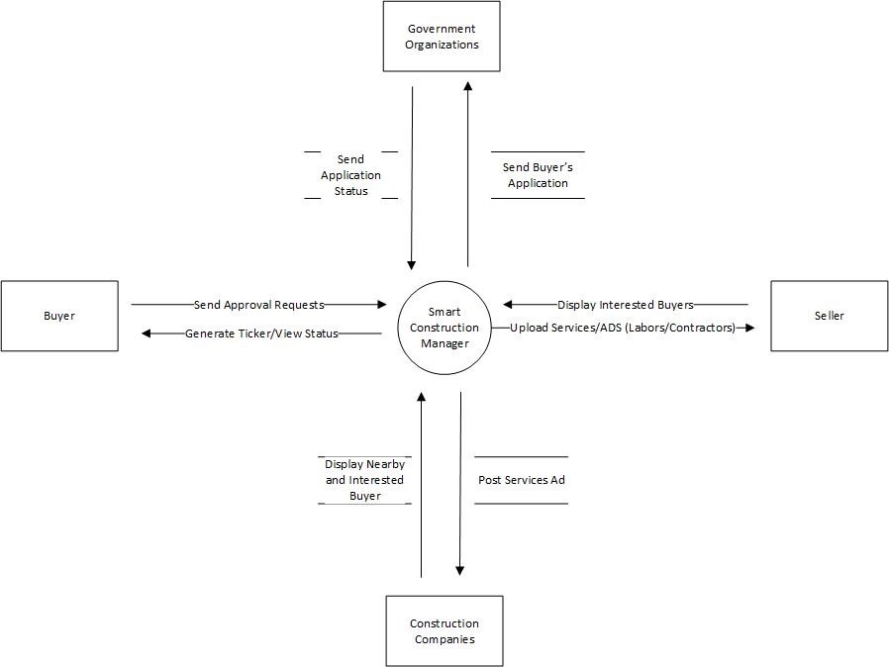
Project Scope
7

Slide 9
Modules [1/2]
8
Module 1: Basics (Login/Sign up)
Module 2: Buy & Sell
Buy and Sell construction related items and services
Post ads of anything you want to sell
Add pictures, specify category and more.
Module 3: Search
Search for the services and equipment required.
Search by Speech
Module 4: Chat
Chat with other SCM users.
Share pictures, Videos, locations and more.
Module 5: Recommendations
See recommended content
Customized recommendations based on user’s interests

Slide 10
Modules [2/2]
9
Module 6: Map Making (3D Modeling)
See 3D models for new constructions site
Share them with architects to customize
Module 7: House Décor (AR)
Visualize the house decorations with AR
Place chairs, tables, sofas and much more in virtual world
Module 8: Application Requests
Communicate with government and official bodies
Apply for Land Transfers and Ownerships
Apply for Utility Services
Module 9: Requests Management
Manage User Requests
Update user about their request.

Slide 11
System Limitation
10
Attested documents cannot be submitted which are essential for the process.
Requires internet connection for buy and sell.
Locally available only.

Slide 12
Software Process Methodology
11
Software Process Methodology
Modified Waterfall
Design Methodology
Component Based Software Engineering

Slide 13
Tools and Technologies
12
Tools | Tools | Version | Rationale
 | MS Visual Studio Code | 2019 | IDE
 | Adobe Photoshop | CSC 6 | Design Work
 | MS Word | 2019 | Documentation
 | MS Power Point | 2019 | Presentation
 | Web Storm | 2020 | IDE
 | PyCharm | 2020 | IDE
 | Android Studio | 2020 | IDE
 | Adobe XD | 2020 | UI UX Design
 | Pencil | 2.0.5 | Mockups Creation
Technologies | Technology | Version | Rationale
 | MongoDB | Updated | DBMS
 | ExpressJS | 4.17.1 | back end web framework
 | React | 17 | Front End Web Framework
 | Node.js | 12.0 | JS Runtime Environment
 | React Native | 0.62 | Hybrid Mobile Development
 | JavaScript | 2020 | Programming Language
 | Bootstrap | 4 | CSS styling Framework
 | Three.js | 2020 | JS Library to create 3d models

Slide 14
Work Division
13
Student Name | Student Registration Number | Responsibility/ Modules
Talha Ejaz | SP18-BCS-161 | (Module6-Module9)
Waleed Butt | SP18-BCS-170 | (Module1-Module5)

Slide 15
Requirements Elicitation Technique(s)
14
The requirements for the project will be gathered using Interviews and online Google Forms.

Slide 16
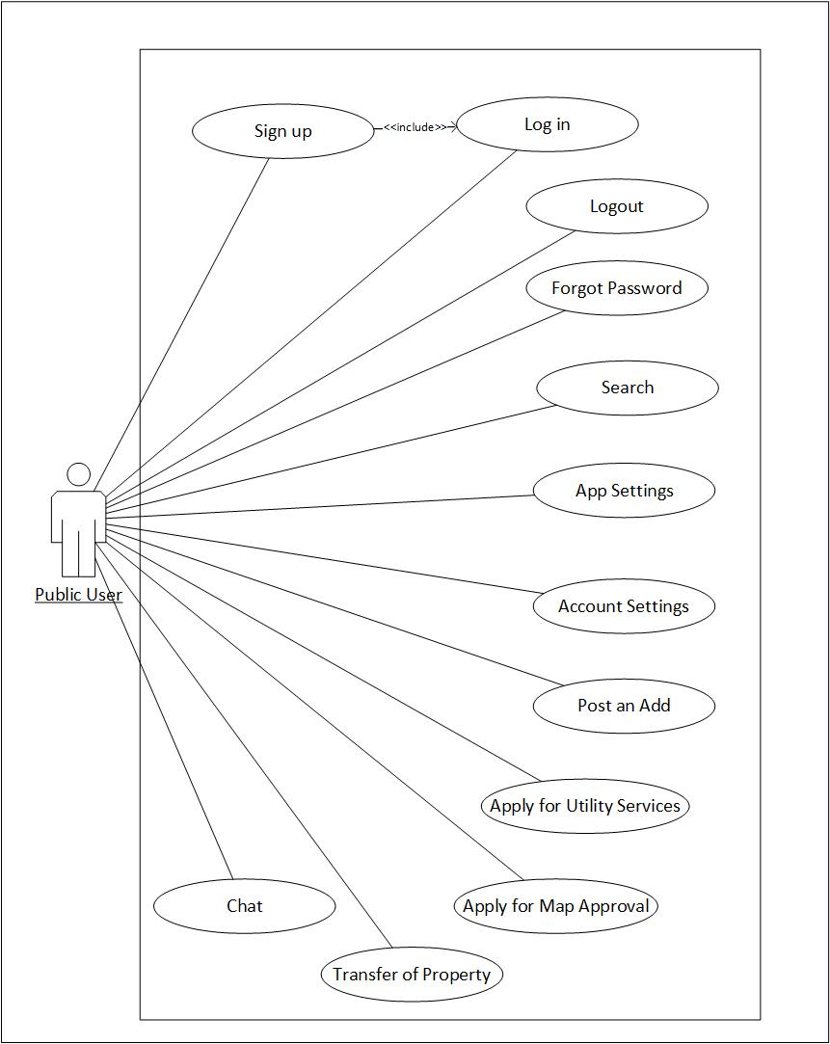
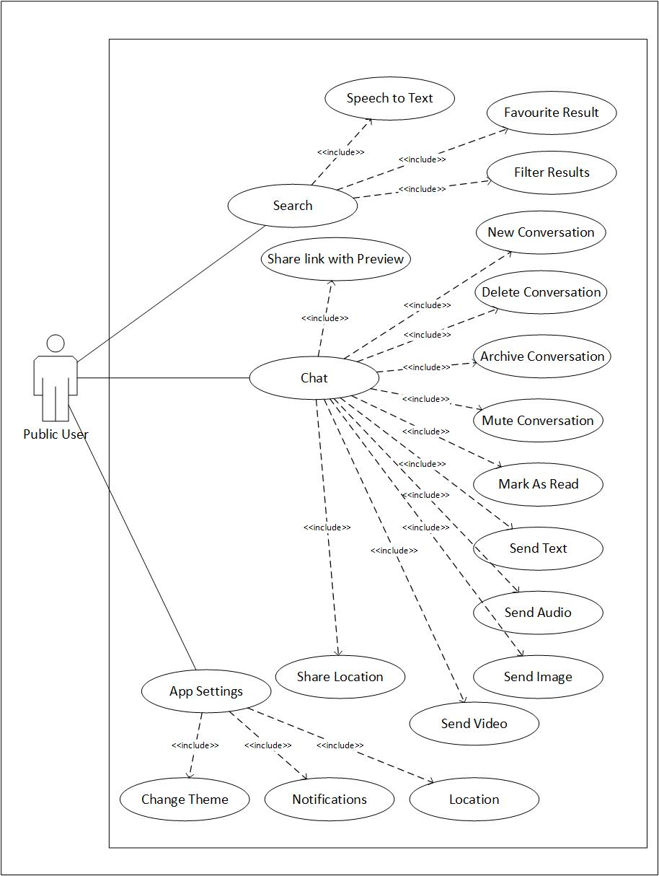
Requirements Identifying Technique
15

Slide 17
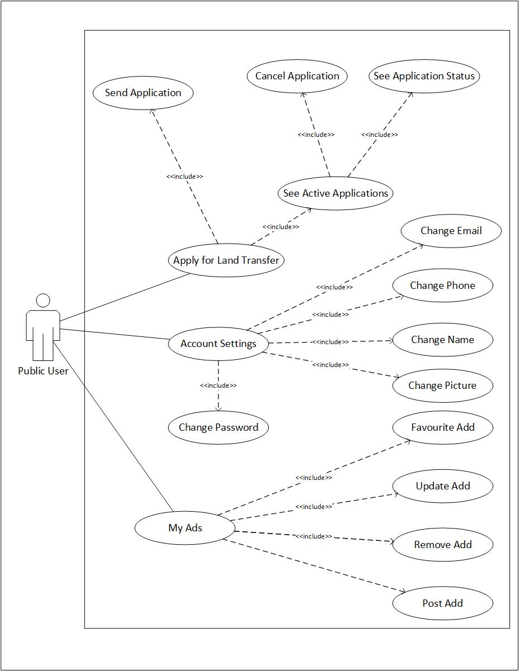
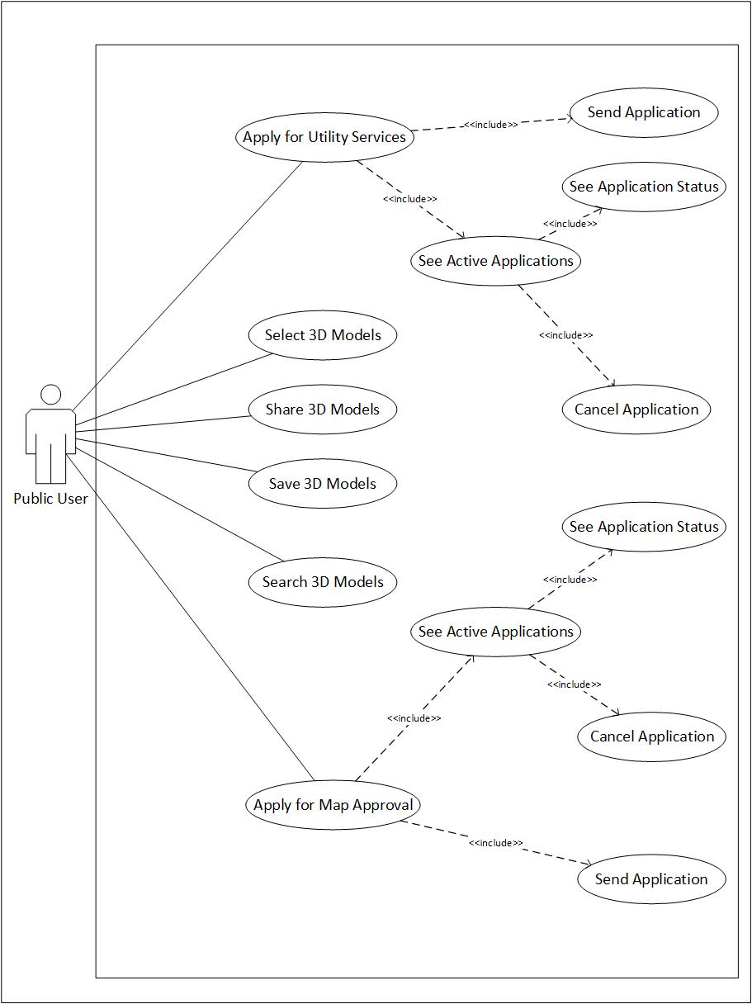
Requirements Identifying Technique (Cont.)
16

Slide 18
Requirements Identifying Technique…
17
Name | Description
M2-UC1: Post an Add | User may post an add for the property or services they want to sale
M3-UC1: Search by Text | This use case deals with the searching. User may search property or service they may require
M3-UC3: Search By Audio | User will be able to Search by speaking. SCM will convert speech to text and search.
M4-UC1: New Conversation | This use case allows user to start a conversation. User may send text, audio, video, image or any file in chat.
M4-UC13: Send Location (Web) | User can share location drop in chat. User will see map open inside of app to drop pin and share.
M5-UC1: Recommendations | User will se recommendations tab in home. This tab will suggest user relevant content making it easier to search.
M6-UC1: 3D Models | User will see pre built 3D models of construction site which will help user decide the map for finalization
M7-UC: Home Décor (AR) | User may design home with the help of AR. User will place AR objects in virtual world to visualize design.
Following are some use cases and their description
Click here to view the detailed document of Use Cases

Slide 19
Functional Requirements
18
Name | Description
FR-2.2.1: Post Add | This FR begins the process of ads posting.
FR-3.3.1: Enter Text to Search | Text in field is used to search relevant items
FR-3.4.1: Speak to Search | Press audio button to start speaking to search
FR-4.11.1: Send File | This requirement is necessary to share file in chat
FR-4.14.1: Send Location | This FR deals with user sharing location in chat.
FR-4.15.2: Link Previews | Link Shared in chat will convert to website title and logo as thumbnail to show preview of link.
FR-5.5.1: Take Feedback | This FR Takes feedback from user on the suggestions shown. User responds by liking or disliking content
FR-6.2.1: Show Model | This FR is to show user the 3D model of construction site
FR-7.3.1: Move by Drag | This FR deals with user moving AR objects in virtual world
FR-8.8.1: Select Authority | User decides to what authority user wants to send application.
Following are some functional requirements and their description
Click here to view the detailed document of FRs

Slide 20
Non-Functional Requirements [1/2]
19
Reliability
The Smart Construction Manager will be a reliable software in terms of execution. The MTBF will be one year. the failures might occur due to server timeouts, request management or system update.
Usability
USE-1: the SCM will allow user with a walkthrough to use the application.
USE-2: After signing up user will be able to view, select certain location with a user-friendly UI.
USE-3: User will be given a popup every time they select a confirmation option regarding any option to ensure error avoidance.
USE-4: Account recovery options will be provided for user in case of forgetting password, through mail and cell no.
USE-5: The user will be able to interact with sellers/buyers, Govt bodies & construction companies to garner the required information and perform the consequent actions efficiently.
USE-6: User can access and view the status of pending requests, moreover user can view all the former projects and their related information. User can access their account through multiple platforms.

Slide 21
Non-Functional Requirements [1/2]
20
Performance
PER-1: User’s profile will be loaded within 4-5 sec on a speed of 10mbps and higher.
PER-2: The request for the forwarding letter might take up to 30-60sec depending upon the response from the concerned server.
PER-3: System can simultaneously facilitate 1000 users without any delay, however response time might vary for a larger figure.
PER-4: The request to check activation status for any option might take up to 30-60sec.
Security
SEC-1: The webpage must be HTTPS with additional security layer.
SEC-2: Captcha will have to completed in case of inactivity.
SEC-3: Website SEO will be done to prevent hacking attacks.

Slide 22
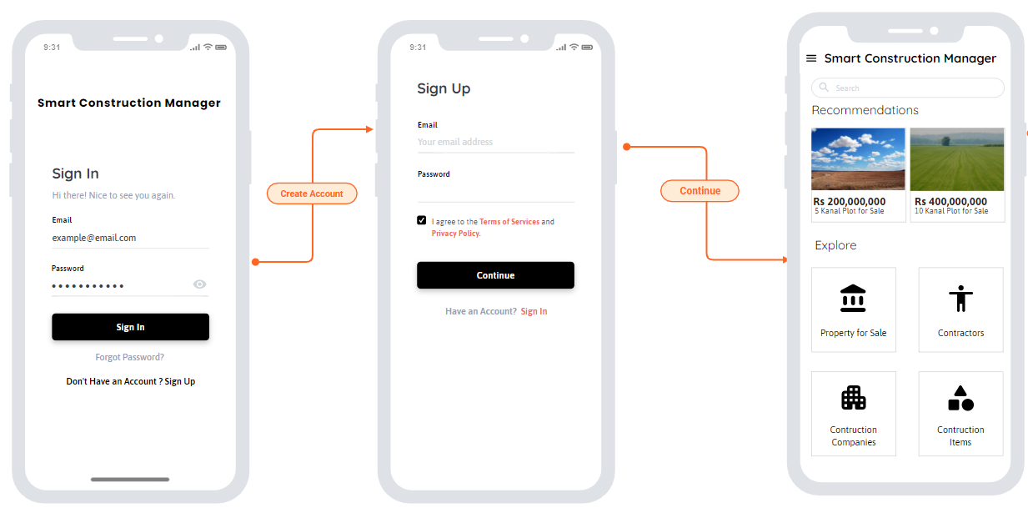
External Interface Requirements
21

Slide 23
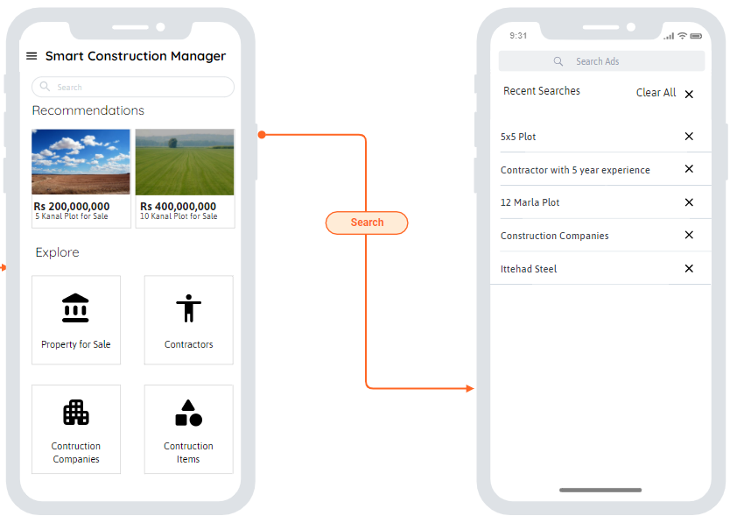
External Interface Requirements
22

Slide 24
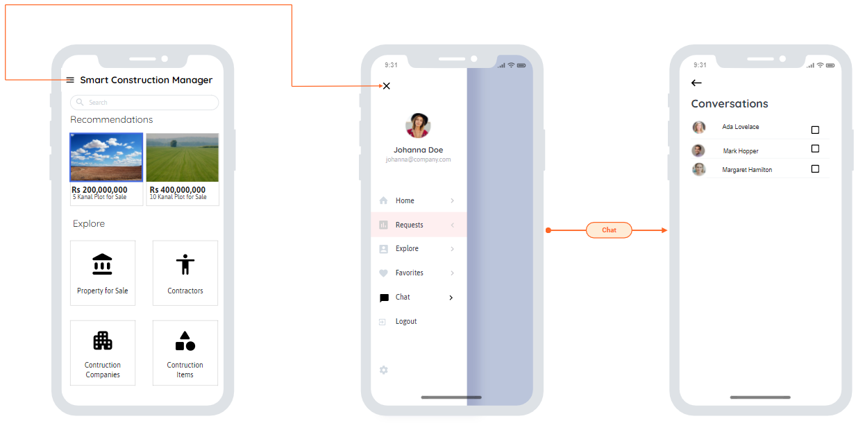
External Interface Requirements
23

Slide 25
Conclusion
24
Smart Construction Manager will be a One Window Application, which will provide the user with an experience of Smart Home Building through multiple Interfaces.
An effective way to communicate with the Development Authorities, to minimize the time effort and ensure transparency of process.
Moreover, basic commodities like Water, Electricity & Gas will be delivered to the user.
Construction Services’ Providence & delivery will be ensured.

Slide 26
References
25
CDA, "FAQs - CDA," CDA, [Online]. Available: http://www.cda.gov.pk/resource_center/faqs.asp#faq1.
Zameen, "Zameen Blog," 2021. [Online]. Available: https://www.zameen.com/blog/.
Graana, "Pakistan's Smartest Property Portal," Graana, [Online]. Available: https://www.graana.com/.
LDA, "Lahore Developement Authority," LDA, [Online]. Available: https://www.lda.gop.pk/page.php?p=TmpReg==.
CDA, Procedures (SOPs), https://www.cda.gov.pk/resource_center/procedures.asp#proc8, 3/7/2021.

